Slide 1

First Principles Thinking
By Manohar Mittapally

Slide 2
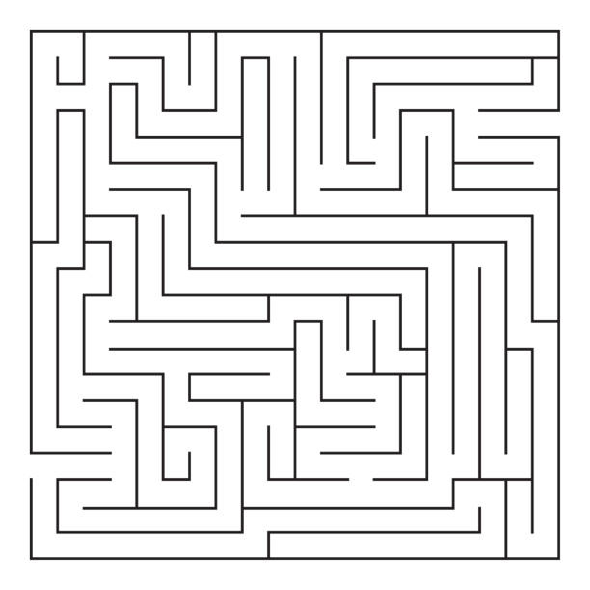
Find the shortest path from A to B
B
A

Slide 3
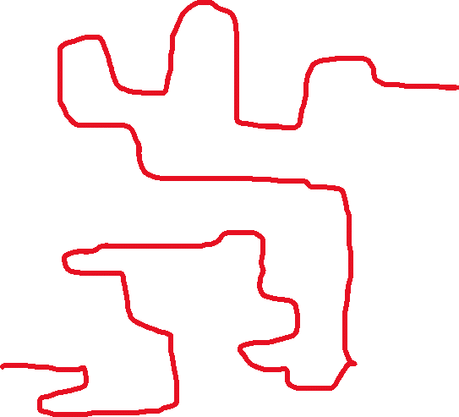
B
A

Slide 4

B
A

Slide 5

Agenda
First Principles
First Principle Thinking
Different Ways
Traditional Thinker
First Principles Thinker
Benefits

Slide 6

First Principles?
The First Principle is a basic proposition or assumption that cannot be derived from any other proposition or assumption.
The First Principle can be considered as the basis or origin from which a thing can be understood in a better manner.
Mathematics
2 x 2 = 4
Something x 0 = 0
Philosophy
Established facts, based on which conclusions are made
Physics
Established Laws of Physics

Slide 7

First Principles Thinking
Consists of breaking down the problem into its fundamental facts and attempting to solve it from that viewpoint.
A basic assumption that cannot be deduced any further.
First principles thinking is a fancy way of saying “think like a scientist.” Scientists don't assume anything.
First principles thinking removes all assumptions when looking for the solution of the problem

Slide 8
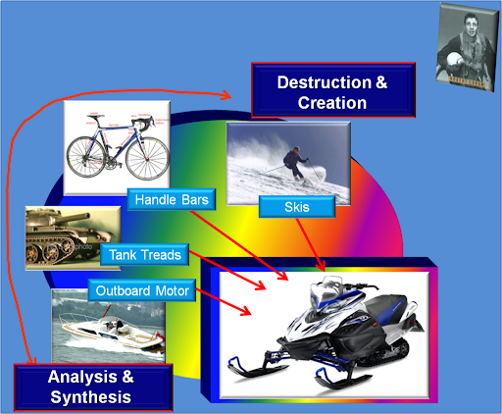
Snow Mobile
Deconstruct
then
Reconstruct.

Slide 9

Different Ways
The Five Whys
Cartesian Doubt
Socratic Questioning

Slide 10
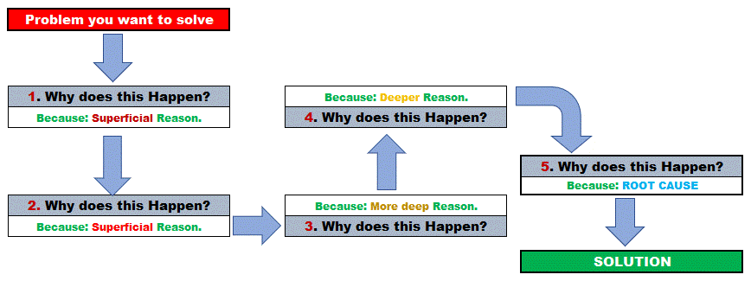
Five Why's

Slide 11
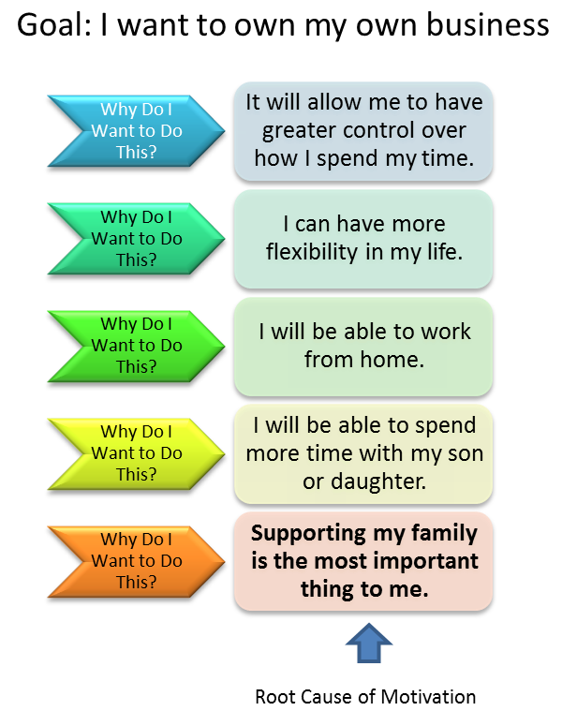
Example

Slide 12
Cartesian Doubt
Approach developed by French Philosopher, Rene Descartes. Based on the foundations of first principles thinking.
Descartes would doubt everything, which he believed he could possibly doubt, systematically, until he would be left with what he supposed were unquestionable truths

Slide 13
Socratic Questioning
Clarifying your thinking and explaining the origins of your ideas (Why do I think this? What exactly do I think?)
1
Challenging assumptions (How do I know this is true? What if I thought the opposite?)
2
Looking for evidence (How can I back this up? What are the sources?)
3
Considering alternative perspectives (What might others think? How do I know I am correct?)
4
Examining consequences and implications (What if I am wrong? What are the consequences if I am?)
5
Questioning the original questions (Why did I think that? Was I correct? What conclusions can I draw from the reasoning process?)
6

Slide 14
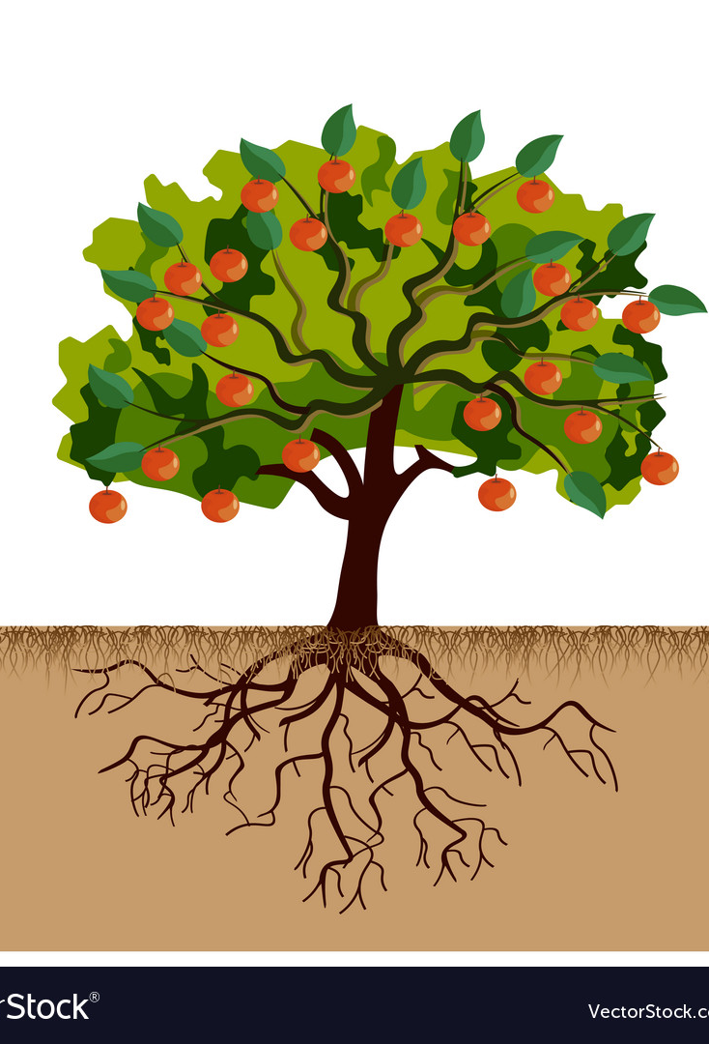
Traditional Thinker
Starts with limitations
Iteration and improvement of an existing path
Explore available solutions in the form of variations of what exists without true knowledge
Look back in time and then determine what to build
Question the path taken to reach a certain goal

Slide 15
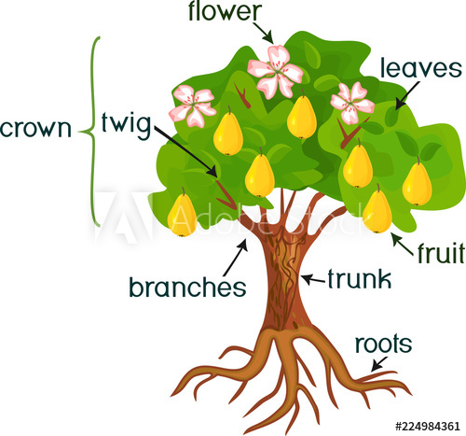
First Principles Thinker
Starts with the possibilities
Define and explore a completely new path
Create a new recipe from the fundamental truth
Look into the future and its needs
Ask the question “What’s the goal”

Slide 16
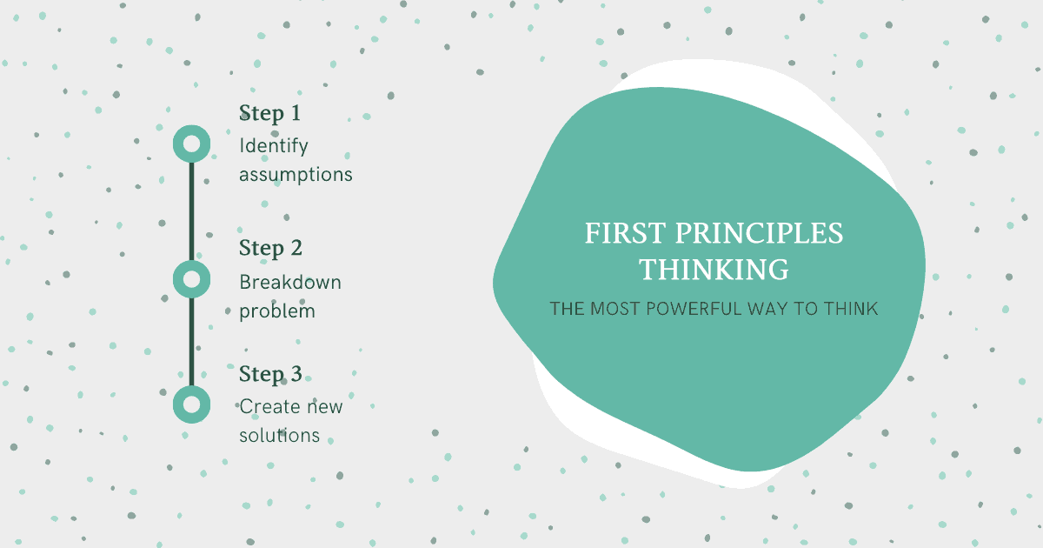

Slide 17

Benefits
Innovation
Optimization
Integration
Dissemination

Slide 18
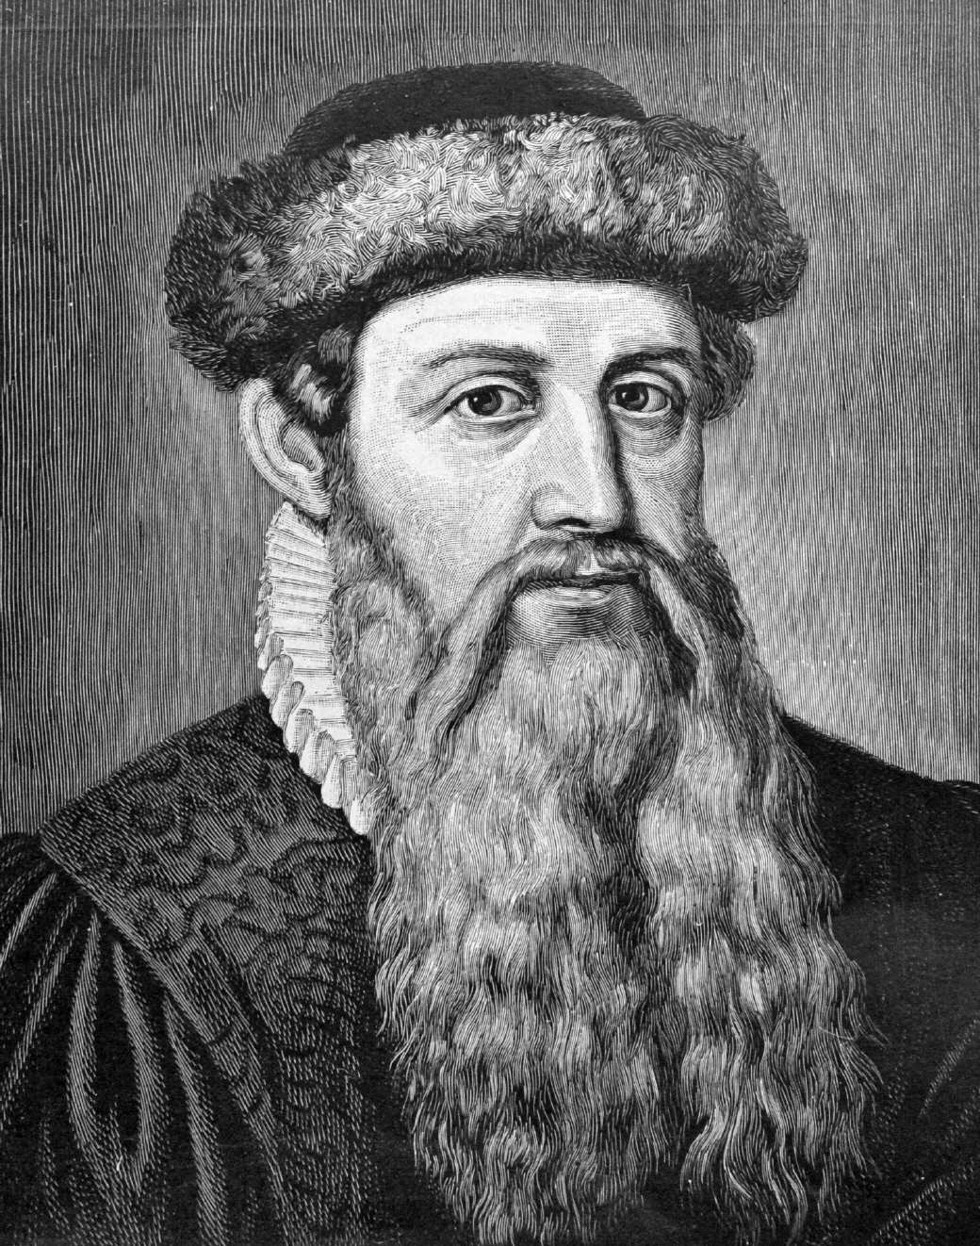
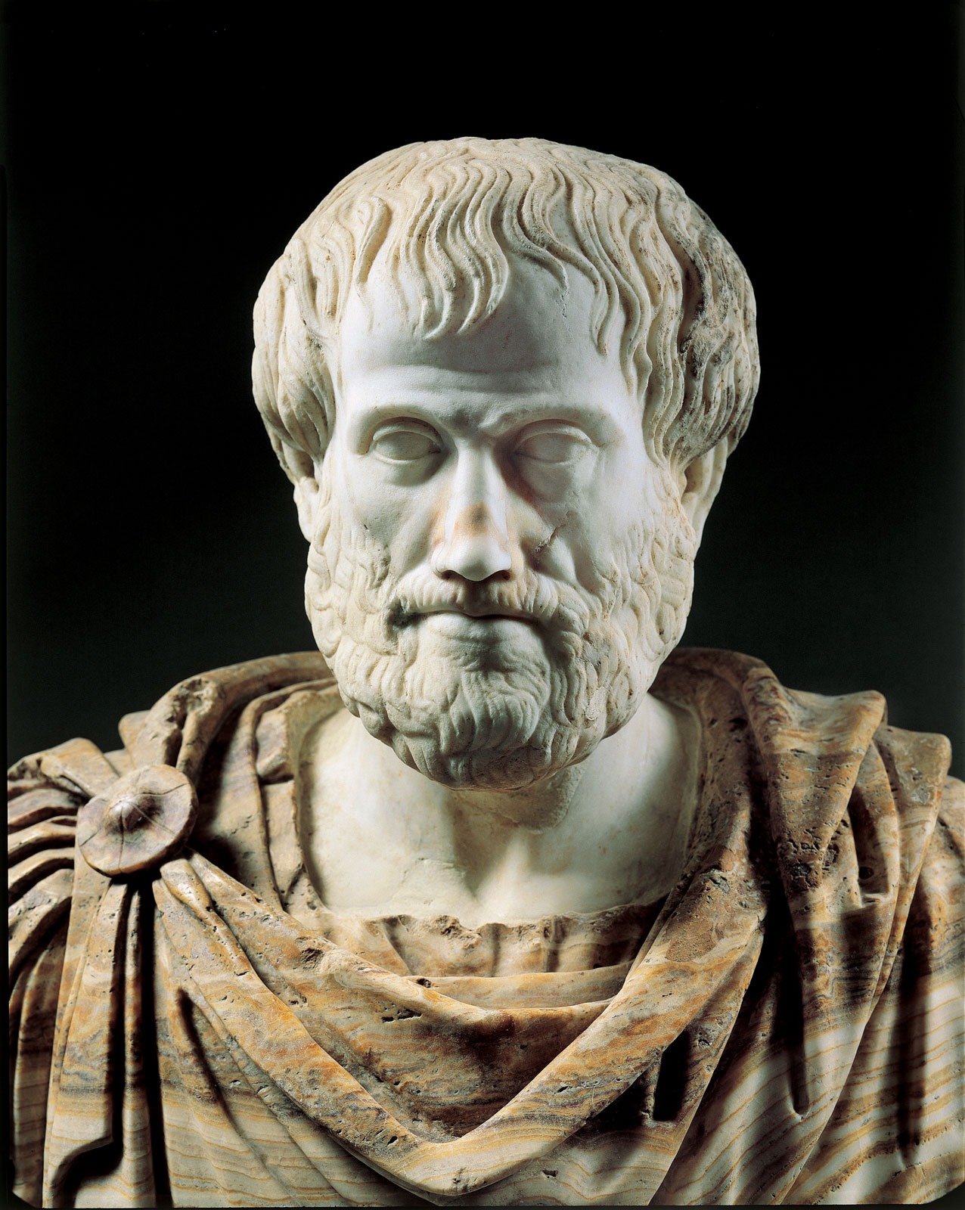
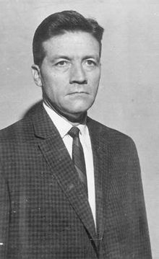
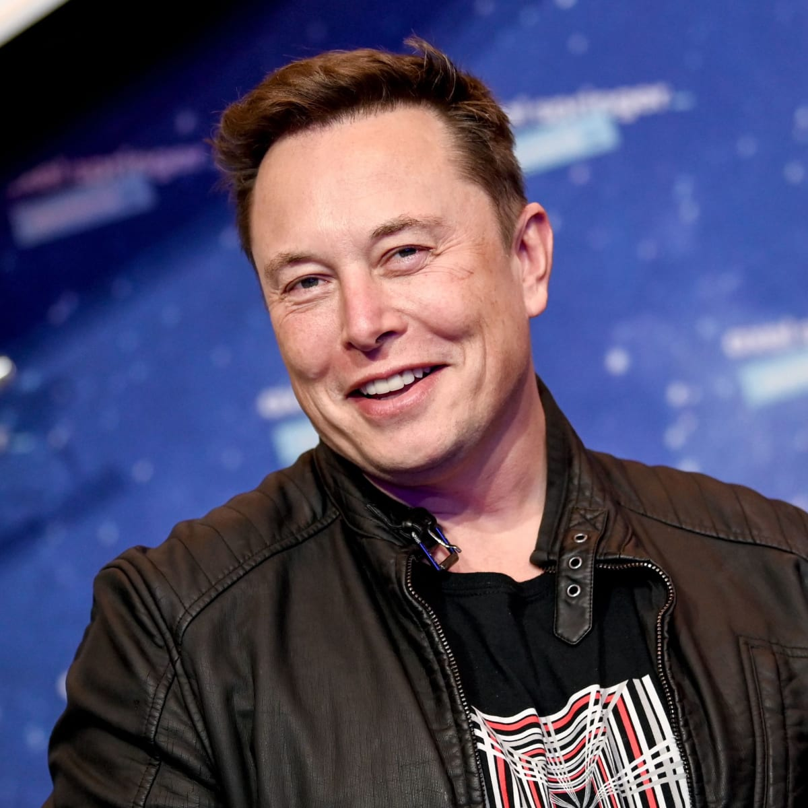
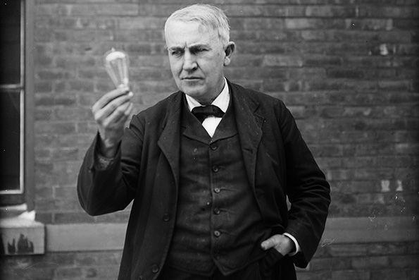
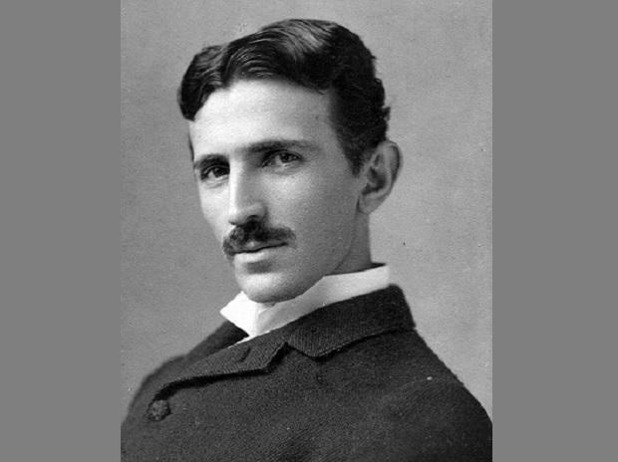
First Principles Thinkers

Slide 19
Find the shortest path from A to B
B
A

Slide 20
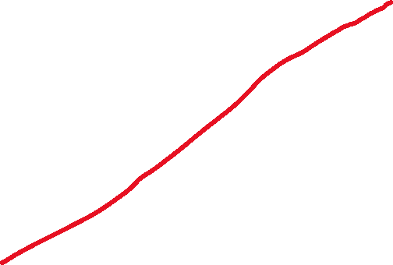
Find the shortest path from A to B
B
A

Slide 21

Any thoughts

Slide 22
References
https://fs.blog/2018/04/first-principles/
https://www.techtello.com/first-principles-thinking/
https://jamesclear.com/first-principles
https://benjaminstrusnik.com/blog/wealth/business/growth/first-principles-thinking/
https://twitter.com/design4ahs/status/1324495442885763072
https://www.zen-tools.net/first-principles-thinking.html

Slide 23

Thank you

